Slide 3
Boston Police Department Case Analysis
(2015-2019)
(2015-2019)
Adam Julius Olof Kviman, Anja Stene ,Mathias Bergane Johansen , Meera Joseph
Norwegian University of Life Sciences
Notes:
Anja

Slide 4
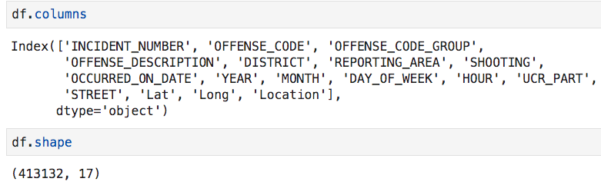
Data set selected:
Crime incident reports are provided by Boston Police Department (BPD) to document the initial details surrounding an incident to which BPD officers respond. This is a dataset containing records from the new crime incident report system, which includes a reduced set of fields focused on capturing the type of incident as well as when and where it occurred. Records in the new system begin in June of 2015.Please find the data set in the link:
https://data.boston.gov/dataset/crime-incident-reports-august-2015-to-date-source-new-system
Norwegian University of Life Sciences
Notes:
Anja

Slide 5
Preprocessing of raw data:
In Real world data are generally incomplete: lacking attribute values, lacking certain attributes of interest, or containing only aggregate data. Noisy: containing errors or outliers. Inconsistent: containing discrepancies in codes or names. The rows containing null values were removed in this approach of data analysis.
Norwegian University of Life Sciences
Notes:
Julius

Slide 6
Data Analysis
The Boston Police department case Analysis…
Norwegian University of Life Sciences
Notes:
Meera

Slide 7
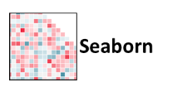
Tools Used
Visualisation to analyse the case trends in Boston over mid 2015 to mid 2019 is represented on the poster .Analysis was carried out using python and libraries like matplotlib ,pandas, seaborn and folium.
Folium
Norwegian University of Life Sciences
Notes:
Meera

Slide 8
Visualisation of Data for Analysis
Volumetric Analysis -Top 10 reported crime incidents
Incident data analysis over time
Month wise distribution
Day wise distribution
Hourly distribution
Incident data analysis over area
Specific Crime Trends
Notes:
Mathias

Slide 9
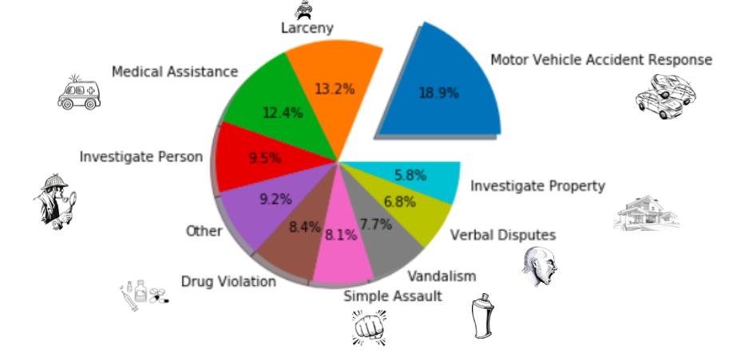
Types of Crimes in Boston :10 most common incidents reported (2015-2019)
The pie chart represents percentage of the 10 most frequently reported incidents in Boston in 2015-2019. Motor Vehicle accident tops the list with almost 18.9% of the total proportion.
Norwegian University of Life Sciences
Notes:
Meera

Slide 10

Analysis of data over Time:-
Months
Days
Hours
Norwegian University of Life Sciences
Notes:
Anja

Slide 11
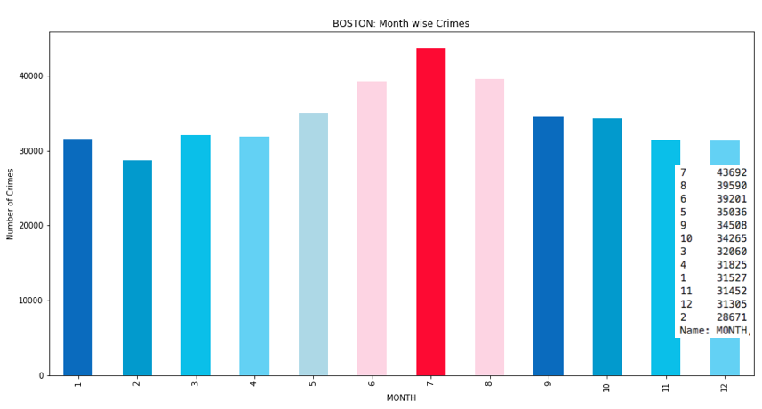
Incident frequency variation over months (2015-2019)
Bar chart represents report frequency variation over months. June has the highest number of crimes.
Norwegian University of Life Sciences
Notes:
Anja

Slide 12
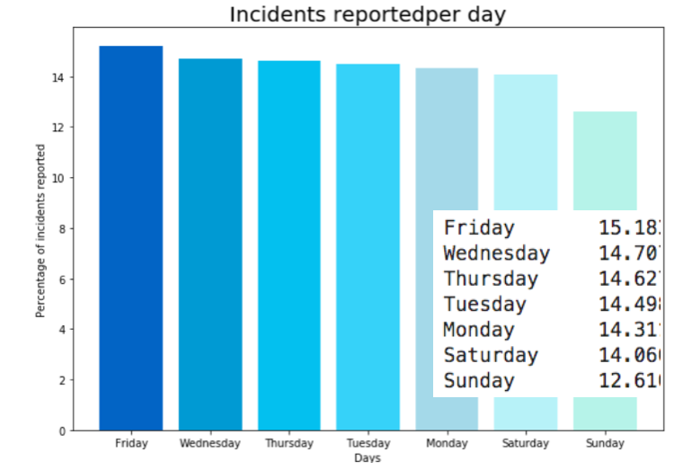
Incident frequency variation over days (2015-2019)
Bar chart represents the distribution of responses occurring each day in Boston during 2015-2019. Approximately 15% of the responses occur on Fridays.
Norwegian University of Life Sciences
Notes:
Anja

Slide 13
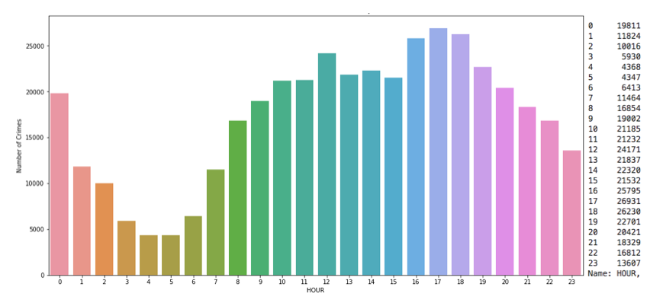
Incident frequency per hour (2015-2019)
The bar chart represents incidents reported in Boston every hour during 2015-2019. Most case were reported during 16:00 hrs to 18:00 hrs with a peak at 17:00 hrs.
Norwegian University of Life Sciences
Notes:
Anja

Slide 14
Incident frequency over the years(2015- 2019)
One of the main reasons to analyse this dataset would be to see if the amount of crime incidents are increasing or decreasing over the years.
Norwegian University of Life Sciences
Notes:
Mathias

Slide 15
Analysis of Data with respect to area
Norwegian University of Life Sciences
Notes:
Julius

Slide 16
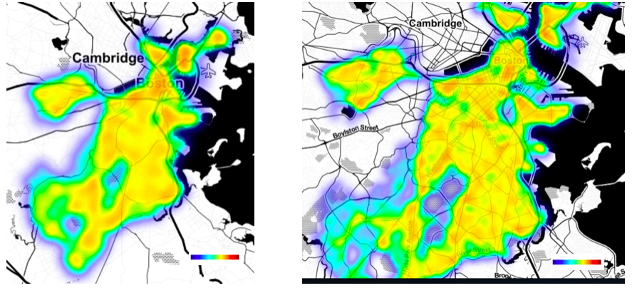
Heat map of events(2016-2017)
The heat map represents the frequency of crimes happening in different streets of Boston in 2016-2017.
The frequency of crimes in different areas are represented by colors ranging from red (representing the highest frequency of crime occurrence) to blue (representing the lowest frequency of crime occurrence)
Norwegian University of Life Sciences
Notes:
Julius

Slide 17
Time interval point plot on the map of Boston
To get more specific information on when and where the incident occurs, we present this with a map over Boston. The points incidents are plotted over a time interval in the map.
Norwegian University of Life Sciences
Notes:
Mathias

Slide 18
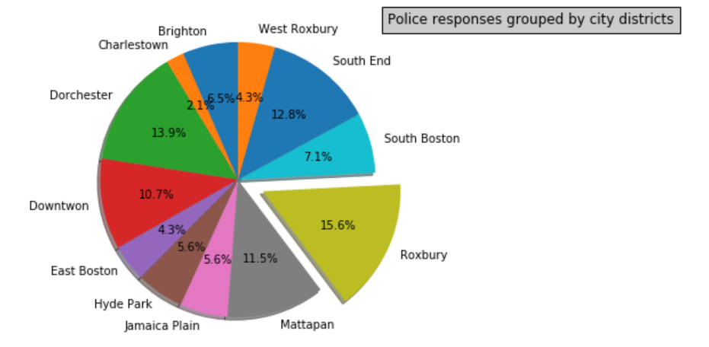
Crime Distribution based on city districts
The figures represent the crime distribution in various city districts of Boston .Roxbury tops the list with 15.6% of reporting.
Source: Wikimedia Common
Fig1
Attribution: Goran tek-en [CC BY-SA 4.0 (https://creativecommons.org/licenses/by-sa/4.0)]
Fig 2
Norwegian University of Life Sciences
Notes:
Julius

Slide 19
Specific Crime trends
Norwegian University of Life Sciences
Notes:
Meera

Slide 20
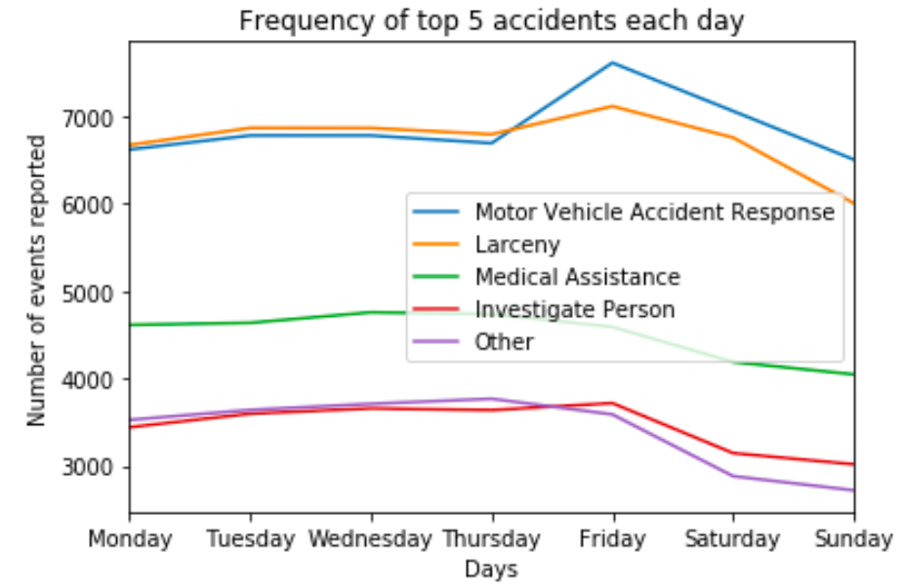
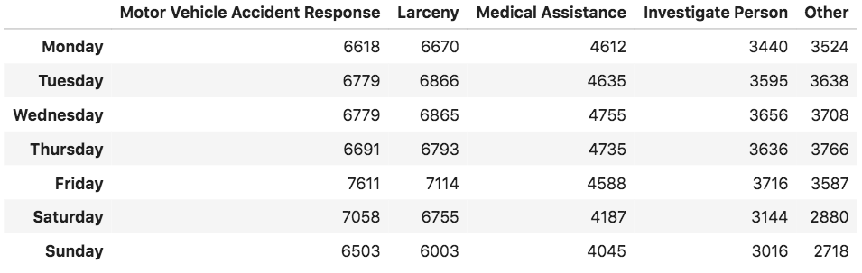
Top 5 incident frequency per day(2015-2019)
We examine the crime trends of the top 5 most commonly reported incidents (Motor vehicle accident response, Larceny, Medical assistance , investigate person) over the days of a week. The following trends are observed:
Interestingly medical assistance , Investigate person and Other decrease over the weekend. Most of the incident groups in the data had their maximum amount of reports on Fridays, except for Medical assistance (Wednesdays) and Other (Thursdays). Motor vehicle accident responses are the most reported incident on all days , with the lowest number reported on Sundays.
Investigate person and Others are the least reported on all days out of the five , with their highest recordings on Friday and Thursday.
Norwegian University of Life Sciences
Notes:
Meera

Slide 21
Incident reporting trend on Boston public holidays.
Interestingly the incident responses goes down on the holidays .This is contrary to the popular belief that crimes tend to increase during the holidays.
The only two holidays were the crime reporting shows an increase are at St Patrick’s day and July 4th.The lowest seem to happen during Christmas.
Notes:
Julius

Slide 22

Results and inference:
Motor vehicle accident response was found to be the most commonly reported incident in Boston during 2015-2019
The month of February was found to be most safest month of the year with least number of reporting's and July was the least safest.
Sunday was found to be the safest day of the week.
Crime reporting are highest at evening 17:00 hrs and lowest at morning 4:00 - 5:00 hrs.
Analysis suggests the prime locations of incident reporting.
Norwegian University of Life Sciences
Notes:
Meera

Slide 23

Discussions
Finding out why most reporting are in July might serve as an added benefit in efficient crime check
Crime reporting are highest in the evenings suggesting that reporting are more common when people are out.
Analysis of prime locations of reporting enables the department and officials to keep a check on the areas and enhance safety .
Holidays show a specific lowered trend in crime reporting which raises questions about the correlation with other factors.
Norwegian University of Life Sciences
Notes:
Mathias

Slide 24
Thankyou

